Slide 1
The Faith of the Kingdom

Slide 2
Matthew 6:19-24
Do not lay up for yourselves treasures on earth, where moth and rust destroy and where thieves break in and steal, but lay up for yourselves treasures in heaven, where neither moth nor rust destroys and where thieves do not break in and steal. For where your treasure is, there your heart will be also.
The eye is the lamp of the body. So, if your eye is healthy, your whole body will be full of light, but if your eye is bad, your whole body will be full of darkness. If then the light in you is darkness, how great is the darkness!
No one can serve two masters, for either he will hate the one and love the other, or he will be devoted to the one and despise the other. You cannot serve God and money.

Slide 3
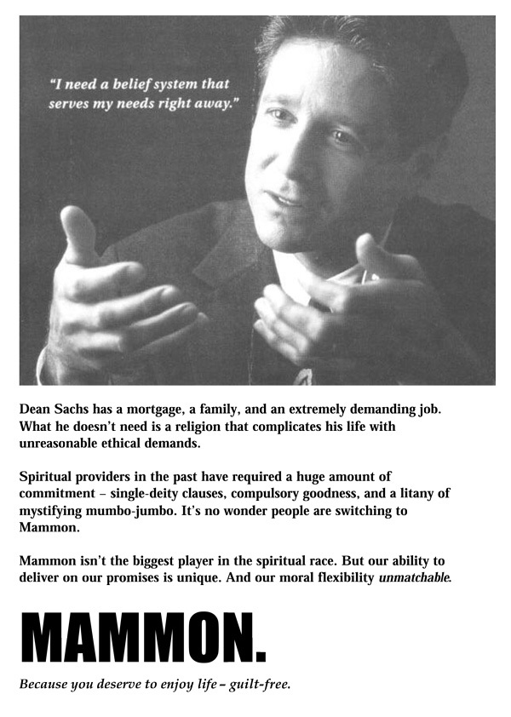

Slide 4
Psalm 78:14-22
In the daytime he led them with a cloud, and all the night with a fiery light. He split rocks in the wilderness and gave them drink abundantly as from the deep. He made streams come out of the rock and caused waters to flow down like rivers.
Yet they sinned still more against him, rebelling against the Most High in the desert. They tested God in their heart by demanding the food they craved. They spoke against God, saying, "Can God spread a table in the wilderness? He struck the rock so that water gushed out and streams overflowed. Can he also give bread or provide meat for his people?"
Therefore, when the LORD heard, he was full of wrath; a fire was kindled against Jacob; his anger rose against Israel, because they did not believe in God and did not trust his saving power.

Slide 5
Matthew 6:25-34
Therefore I tell you, do not be anxious about your life, what you will eat or what you will drink, nor about your body, what you will put on. Is not life more than food, and the body more than clothing?
Look at the birds of the air: they neither sow nor reap nor gather into barns, and yet your heavenly Father feeds them. Are you not of more value than they?
And which of you by being anxious can add a single hour to his span of life?
And why are you anxious about clothing? Consider the lilies of the field, how they grow: they neither toil nor spin, yet I tell you, even Solomon in all his glory was not arrayed like one of these. But if God so clothes the grass of the field, which today is alive and tomorrow is thrown into the oven, will he not much more clothe you, O you of little faith?
Therefore do not be anxious, saying, 'What shall we eat?' or 'What shall we drink?' or 'What shall we wear?‘ For the Gentiles seek after all these things, and your heavenly Father knows that you need them all. But seek first the kingdom of God and his righteousness, and all these things will be added to you.
Therefore do not be anxious about tomorrow, for tomorrow will be anxious for itself. Sufficient for the day is its own trouble.

Slide 6
Deuteronomy 8:2-5
And you shall remember the whole way that the LORD your God has led you these forty years in the wilderness, that he might humble you, testing you to know what was in your heart, whether you would keep his commandments or not.
And he humbled you and let you hunger and fed you with manna, which you did not know, nor did your fathers know, that he might make you know that man does not live by bread alone, but man lives by every word that comes from the mouth of the LORD. Your clothing did not wear out on you and your foot did not swell these forty years.
Know then in your heart that, as a man disciplines his son, the LORD your God disciplines you.

Slide 7
Faith as Trust and Reliance
Hebrews 11:1
Now faith is the assurance of things hoped for, the conviction of things not seen.
Hebrews 11:6
And without faith it is impossible to please him, for whoever would draw near to God must believe that he exists and that he rewards those who seek him.
Hebrews 11:13
These all died in faith, not having received the things promised, but having seen them and greeted them from afar, and having acknowledged that they were strangers and exiles on the earth.

Slide 8
Genesis 3:1-6
Now the serpent was more crafty than any other beast of the field that the LORD God had made. He said to the woman, "Did God actually say, 'You shall not eat of any tree in the garden'?"
And the woman said to the serpent, "We may eat of the fruit of the trees in the garden, but God said, 'You shall not eat of the fruit of the tree that is in the midst of the garden, neither shall you touch it, lest you die.'"
But the serpent said to the woman, "You will not surely die. For God knows that when you eat of it your eyes will be opened, and you will be like God, knowing good and evil."
So when the woman saw that the tree was good for food, and that it was a delight to the eyes, and that the tree was to be desired to make one wise, she took of its fruit and ate, and she also gave some to her husband who was with her, and he ate.

Slide 9
Romans 14:17
For the kingdom of God is not a matter of eating and drinking but of righteousness and peace and joy in the Holy Spirit.

Slide 10
C. S. Lewis, The Weight of Glory”
“It would seem that Our Lord finds our desires not too strong, but too weak. We are half-hearted creatures, fooling about with drink and sex and ambition when infinite joy is offered us, like an ignorant child who wants to go on making mud pies in a slum because he cannot imagine what is meant by the offer of a holiday at the sea. We are far too easily pleased.”

Slide 11
The Faith of the Kingdom

