Slide 1
Disciple
Do You See A
In The Mirror?
Luke 6:40

Slide 3
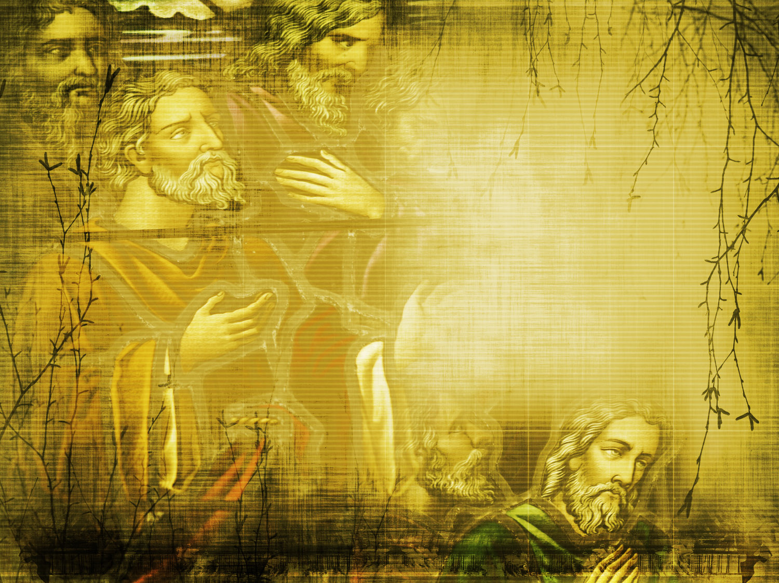
John: The Disciple Whom Jesus Loved
John 21:20-25

Slide 4
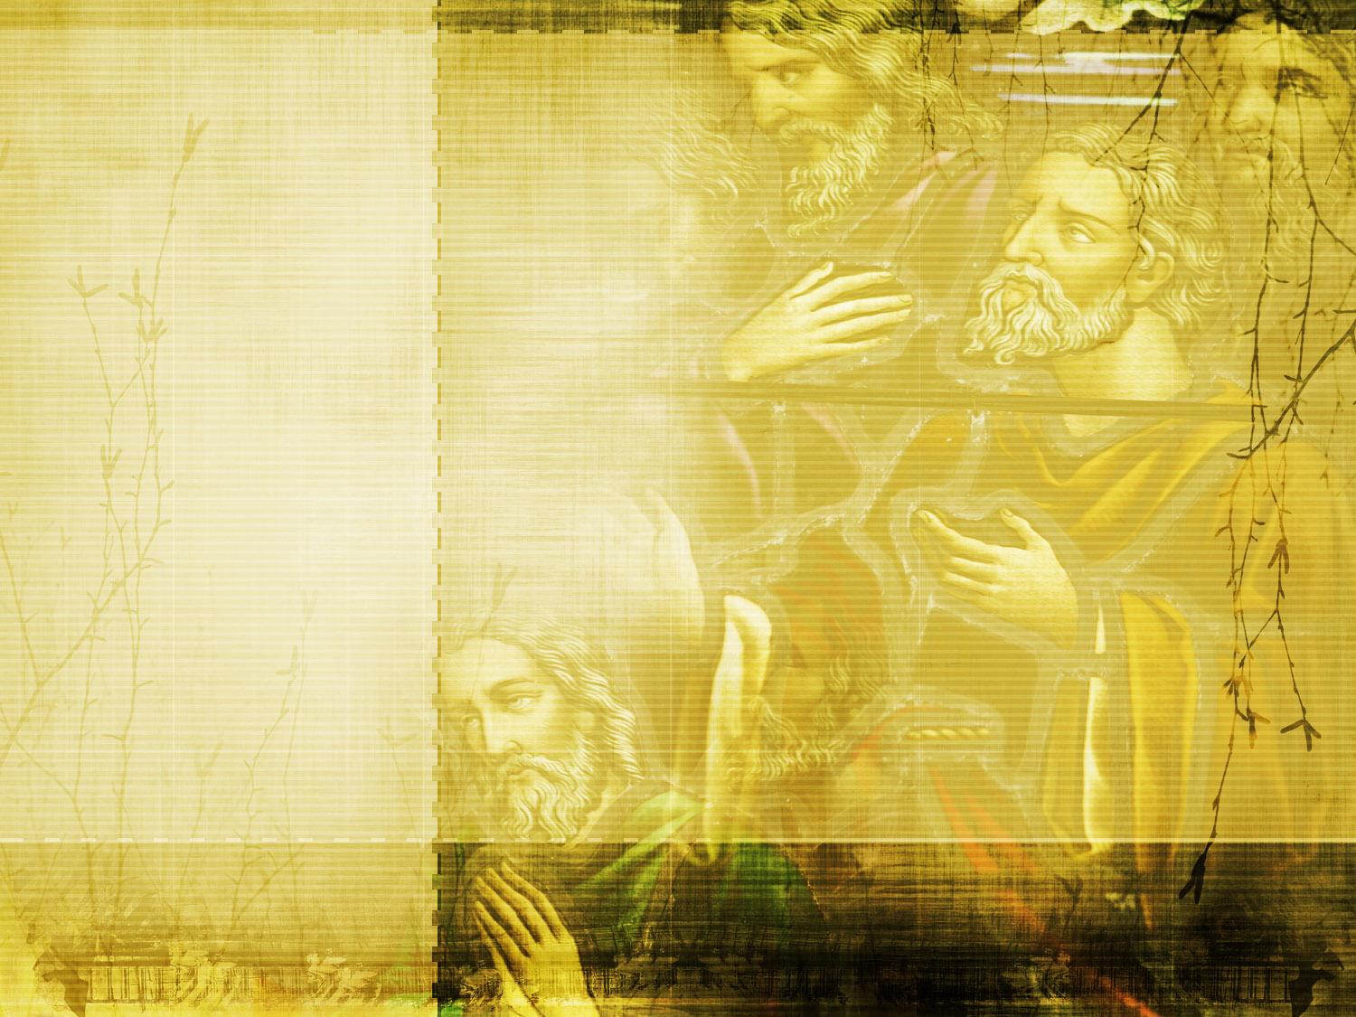
Jesus Loves You Where You Are
John The Disciple Whom Jesus Loved

Slide 5
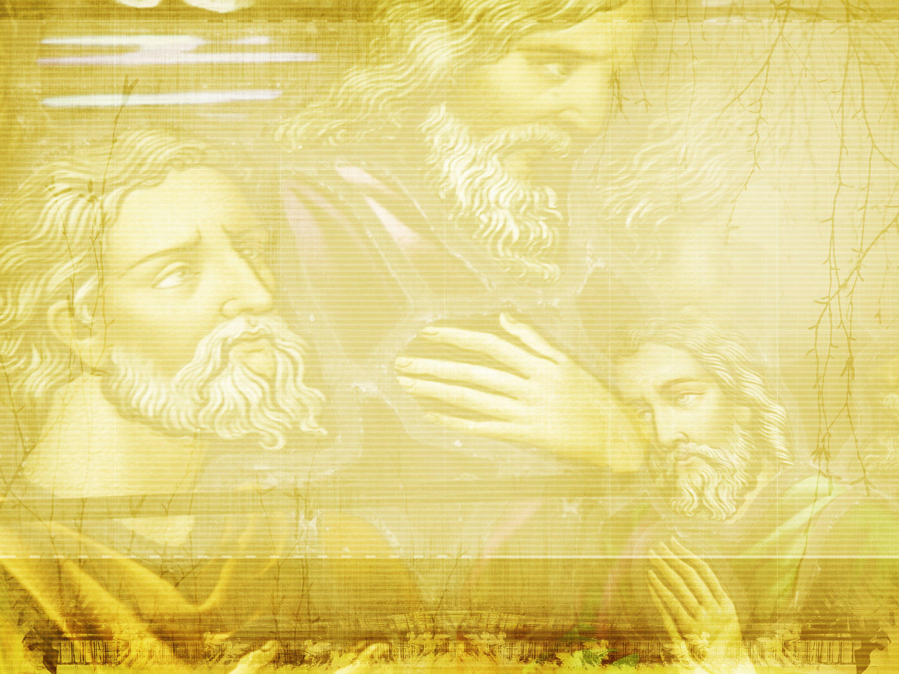
“The disciple whom Jesus loved”
John 13:23 – sitting next to Jesus at Last Supper, leaning on His shoulder
John 19:26 – standing at the foot of the cross, accepting responsibility for Mary
John 20:2 – when he first heard of the empty tomb and ran to see for himself
John 21:7 – when he recognized the resurrected Lord walking on the seashore
John 21:20 – following behind Peter and Jesus as they talked and Peter was restored.

Slide 6
“The disciple whom Jesus loved”
Stop trying to earn Jesus’ love!
“We love Him because He first loved us” – 1John 4:19
Understand that you are loved!
Your Personhood
You’re Valuable
His love Moves & Changes Us – New Birth

Slide 7
Jesus Knows What You Are Capable Of
John The Disciple Whom Jesus Loved

Slide 8
“If I will…”
He sees Potential – more than we see in ourselves
You can be a Christian (Acts 11:28)
You can be a Servant (John 15:19-20)
You can Influence a soul for Christ (Acts 8:4)
He provides time to spiritually mature (2 Pet. 1:5-8)
He has a will, a plan, for you.

Slide 9
We Can Love Others As Jesus Loves Them
John
The Disciple Whom Jesus Loved

Slide 10
Love the Brethren
“A new commandment I give to you, that you love one another; as I have loved you, that you also love one another. By this all will know that you are My disciples, if you have love for one another.” – John 13:34-35

Slide 11
Love the Brethren
“If someone says, "I love God," and hates his brother, he is a liar; for he who does not love his brother whom he has seen, how can he love God whom he has not seen? And this commandment we have from Him: that he who loves God [must] love his brother also.” – 1 John 4:20-21

Slide 12
Love the Brethren
“By this we know love, because He laid down His life for us. And we also ought to lay down [our] lives for the brethren. But whoever has this world's goods, and sees his brother in need, and shuts up his heart from him, how does the love of God abide in him? My little children, let us not love in word or in tongue, but in deed and in truth.” – 1 John 3:16-18

Slide 13
Love Our Neighbor
“For all the law is fulfilled in one word, even in this: "You shall love your neighbor as yourself.” – Galatians 5:14
“Therefore, whatever you want men to do to you, do also to them, for this is the Law and the Prophets.” – Matthew 7:14

Slide 14
Love Our Enemies
“But I say to you who hear: Love your enemies, do good to those who hate you, bless those who curse you, and pray for those who spitefully use you…But love your enemies, do good, and lend, hoping for nothing in return; and your reward will be great, and you will be sons of the Most High. For He is kind to the unthankful and evil.” – Luke 6:27-28, 35

Slide 15
John: The Disciple Whom Jesus Loved
John 21:20-25

