Slide 1
Disciple
Do You See A
In The Mirror?
Luke 6:40

Slide 3
A Disciple LEARNS from GOD
Matthew 10:24-25

Slide 4
A Disciple LEARNS from GOD
1
Learn To
Learn from Christ

Slide 5
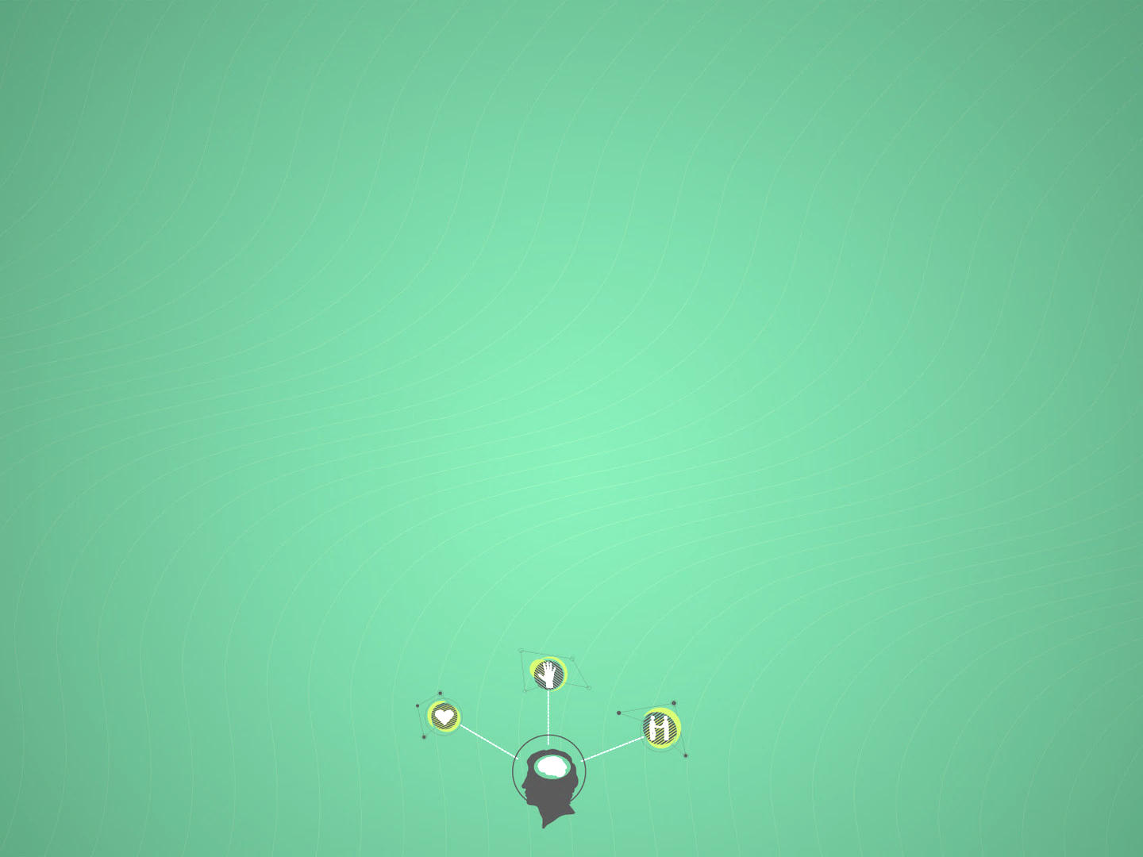
DISCIPLE: Follow & Learn
Then Thomas, who is called the Twin, said to his fellow disciples, "Let us also go, that we may die with Him.“ (John 11:16)
"Go therefore and make disciples of all the nations, baptizing them in the name of the Father and of the Son and of the Holy Spirit, teaching them to observe all things that I have commanded you; and lo, I am with you always, even to the end of the age." Amen. (Matthew 28:19-20)

Slide 6
A Disciple LEARNS from GOD
2
Learn To
Study Scripture

Slide 7
Study Scripture
“Be diligent to present yourself approved to God, a worker who does not need to be ashamed, rightly dividing the word of truth.” - 2 Timothy 2:15
“how that by revelation He made known to me the mystery (as I have briefly written already, by which, when you read, you may understand my knowledge in the mystery of Christ)” – Ephesians 3:3-4

Slide 8
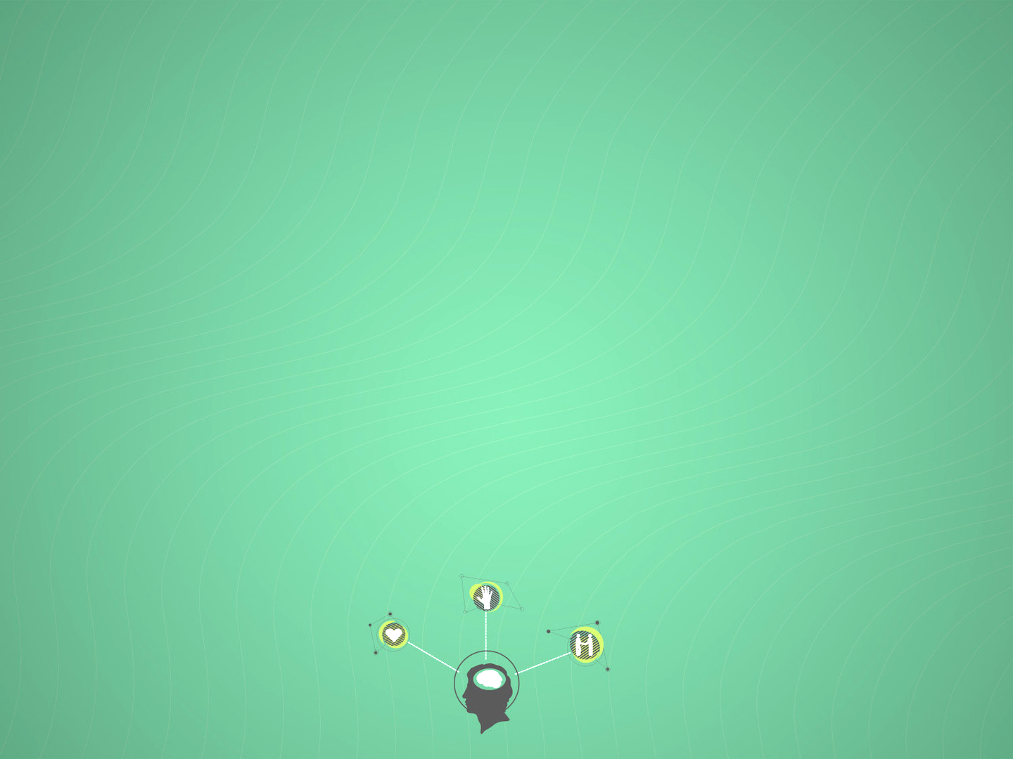
Practical Helps
Bible classes for all ages
Daily Bible Reading Schedule
Daily Email/Blog Messages

Slide 9
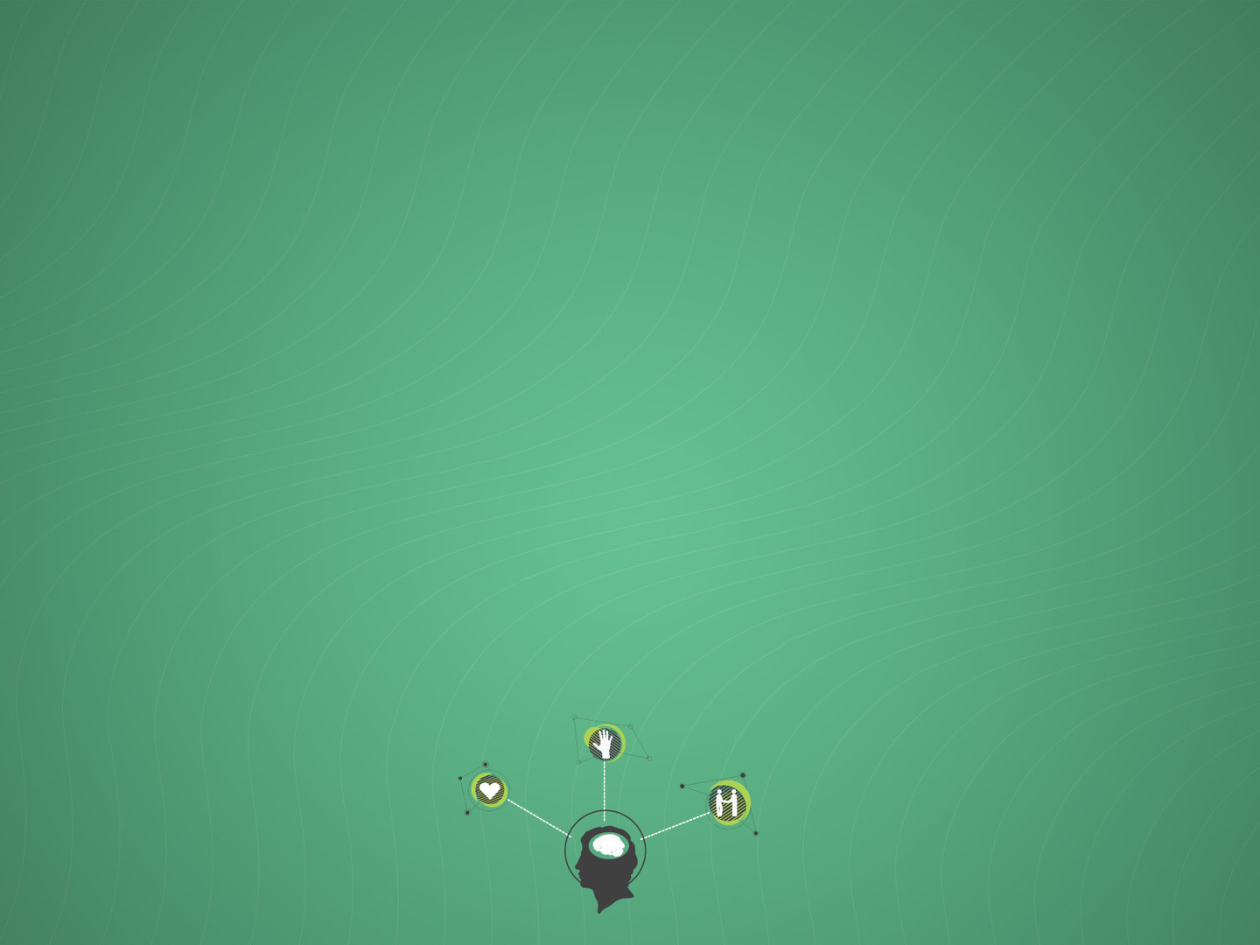
Get Started:
Set a Time and Place for daily Bible reading

Slide 10
A Disciple LEARNS from GOD
3
Learn To
Pray Regularly

Slide 11
Disciples Pray
“Now it came to pass, as He was praying in a certain place, when He ceased, that one of His disciples said to Him, “Lord, teach us to pray, as John also taught his disciples.” – Luke 11:1
“Again, a second time, He went away and prayed, saying, “O My Father, if this cup cannot pass away from Me unless I drink it, Your will be done.” – Matthew 26:42

Slide 12
Learned Virtues
Dependence on God (James 4:15)
Humility before God (James 1:5; 1 John 1:9)
Gratitude toward God (1 Thessalonians 5:17-18)
Contentment with God (2 Corinthians 12:7-10)

Slide 13
Get Started:
Set a Time and Place for daily Prayer

Slide 14
A Disciple LEARNS from GOD
4
Learn Through
Church Membership & Ministry

Slide 15
Membership & Ministry
“And He Himself gave some to be apostles, some prophets, some evangelists, and some pastors and teachers, for the equipping of the saints for the work of ministry, for the edifying of the body of Christ, till we all come to the unity of the faith and of the knowledge of the Son of God, to a perfect man, to the measure of the stature of the fullness of Christ” – Ephesians 4:11-13

Slide 16
We Grow Together & Together We Grow
Learn through Worship (Colossians 3:17)
Learn from Pastors, Evangelists, & Teachers (Ephesians 4:11-13)
Good, godly Examples (Hebrews 13:7; Titus 2:3-5; 1 Peter 5:3)
Support via Association with Disciples (1 Thessalonians 4:9-12; 2 Peter 1:1)

Slide 17
Get Started:
Learn about membership at Bartlett Congregation Today

Slide 18
A Disciple LEARNS from GOD
Matthew 10:24-25

